Slide 1


Romania:
Economic Situation
And Prospects
September 2016
1
Notes:
1

Slide 2
Key Macroeconomic Indicators
Source: National Institute of Statistics, National Bank of Romania, Eurostat, Ministry of Public Finance, The Bleyzer Foundation

Slide 3
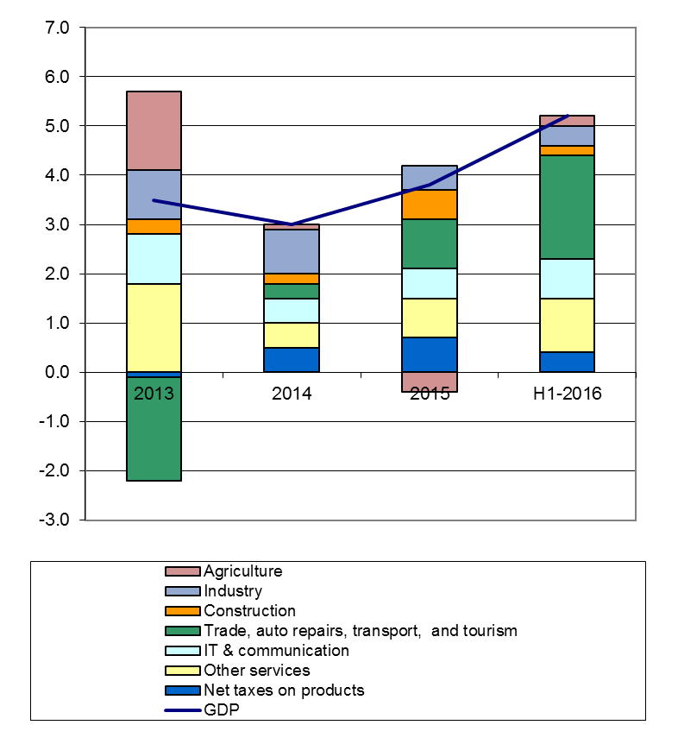
Sources of Economic Growth – Supply Side
Contributions to GDP Growth
by Resources, percentage points
GDP expanded by 3.8% in 2015 and by 5.2% in H1-2016;
On the supply side of GDP, since 2015, trade, auto repairs, transport and tourism have been the main growth drivers, adding 2.1% to the growth in H1-2016 GDP
  In June 2015, due to increasing food consumption, the government cut the VAT for food products (other than bread and pastry) from 24% to 9%
  In January 2016, the standard VAT rate for all other products was reduced from 24% to 20%
Other growth areas included IT & Communications which contributed 0.8% to H1-2016 growth
Construction grew little, adding a low 0.2% to the H1-2016 growth, in spite of the need to upgrade the country’s infrastructure.
Source: National Institute of Statistics, The Bleyzer Foundation

Slide 4
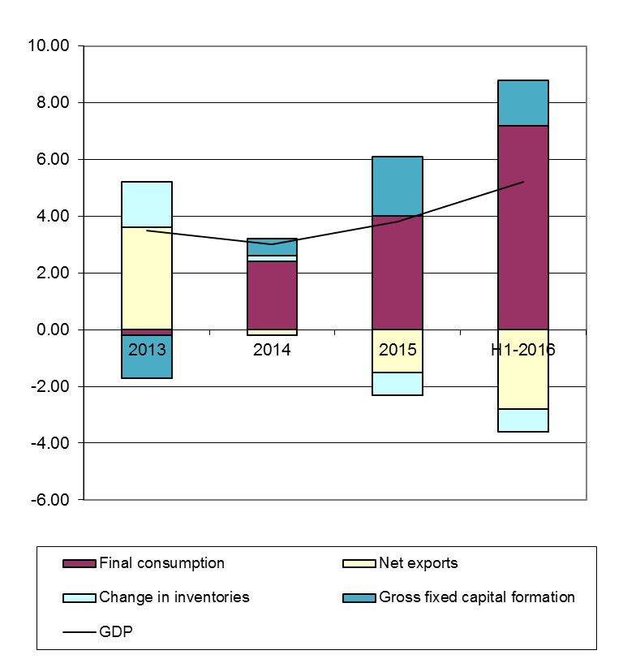
Sources of Economic Growth – Demand Side
Contributions to GDP Growth by Uses
Components, percentage points
On the demand side of GDP, since 2014 final consumption has been the main GDP growth contributor.
  The contribution of households consumption to the H1-2016 GDP growth rate was 6.8%, while the general government consumption contribution was a lower 0.4%;
Gross fixed capital formation contributed 1.6% to H1-2016 economic growth;
But net exports had a negative 2.8% contribution to GDP growth, as higher consumption led to higher imports and higher trade deficits.
Source: National Institute of Statistics, The Bleyzer Foundation

Slide 5
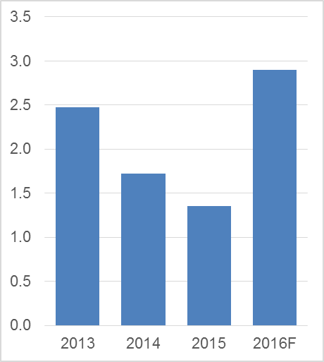
Fiscal Policy
Consolidated Budget Deficit,
% of GDP
Romania has maintained low consolidated fiscal budget deficits by reducing public investments in order to finance increases in public wages (+10.2% in 2016) and to cut Value Added Taxes, as noted earlier.
The fiscal budget deficit during January-July 2016 was 0.2% of the GDP, compared with a 1.0% surplus in the same period of last year.
The fiscal budget is expected to show a 2.9% of GDP deficit in 2016, as usually budget deficit jumps by 1.5%-2.0% of GDP during the last month of the year;
Parliamentary elections are planned for December 2016, and politicians are likely to be generous with budget expenditures. The government is a caretaker one, without parliamentary support, so it can hardly oppose these excesses.
Source: National Bank of Romania, Ministry of Public Finance, The Bleyzer Foundation

Slide 6
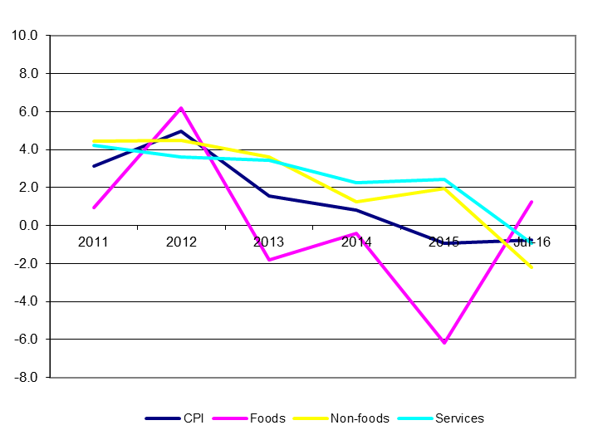
Monetary Policy and Inflation
Consumer prices,
% annual change eop
Inflation at end-July 2016 was -0.8% yoy due to negative contributions of -2.2% yoy and -0.9% yoy from non-food and services prices, respectively;
The VAT cut implemented in January 2016 for non-food goods led to the above declines in prices
The base effect from the cut of VAT on food products VAT has already expired, with food product prices increasing 1.3% yoy in July 2016;
The NBR expects the end-2016 inflation to remain negative, at -0.4% yoy;
Source: National Institute of Statistics, The Bleyzer Foundation

Slide 7
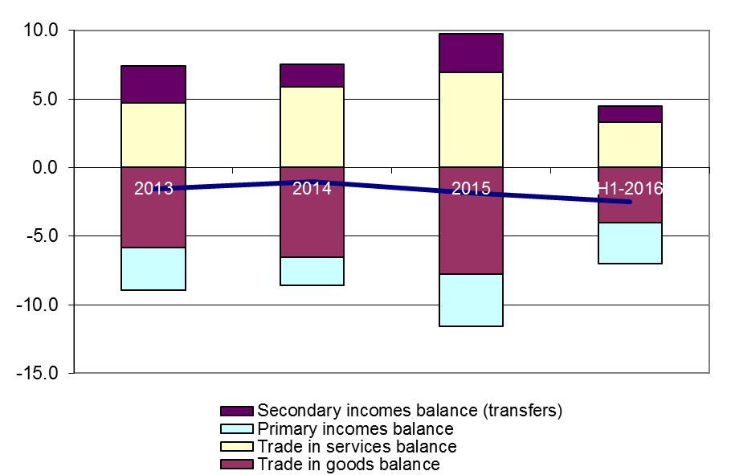
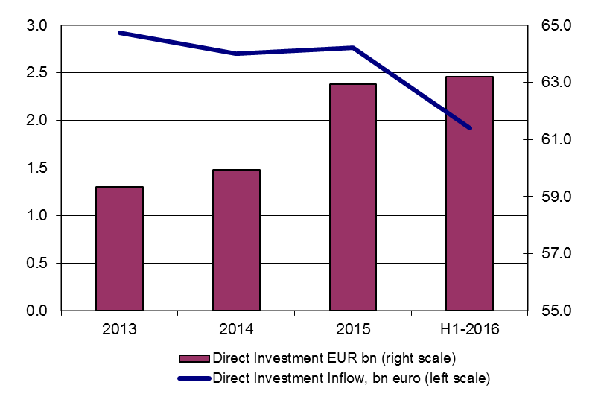
Current Account and Foreign Trade
Current account, bn Euro
Romania’s current account deficits and the level of public debt are comfortable, thanks to reform carried out in the recent past
However, the current account deficit is widening due to increases in imports associated with expanded consumption.
But the CA deficit is still at manageable levels at 1.1% of the GDP in 2015 and expected to reach 2.9% of GDP in 2016
During H1-2016, CA deficit reached EUR 2.5 billion, up from EUR 0.4 billion in H1-2015
The increase is mainly due to deficits in the trade of goods, which reached EUR 4.0 billion during H1-2016, up from EUR 2.9 billion during H1-2015;
Foreign direct investments amounted to EUR 1.9 billion during H1-2016;
Public and publicly guaranteed debt remains at low levels by EU standards, at 38.4% of GDP as of end-2015;
Net FDI inflows
Source: National Institute of Statistics, National Bank of Romania, Ministry of Public Finance, The Bleyzer Foundation

Slide 8
Outlook for 2016 and 2017
In 2016, GDP growth will reach 5.0%, slightly slowing down during 2017
Consumption will remain the main GDP growth driver, due to cuts in the VAT rate
Increasing consumption should lead to increases in trade and current account deficits:
  The trade deficit was up 30% yoy during Jan-Jul 2016 reaching EUR 5.1 billion
  The current account deficit reached EUR 2.5 billion over January-June 2016, up from EUR 0.4 billion over the same period of last year. For 2016 the CA deficit is expected at 2.9% of the GDP
The year 2016 is been strongly influenced by political life:
  In December 2016 Romania will have parliamentary elections
  The current government is a technocrat one, led by Mr. Dacian Ciolos, an ex-EU Agriculture Commissioner. Mr. Ciolos stated it will not take part in the 2016 elections
  All parliamentary parties are eager to distribute public money ahead of the elections, with little consideration to financing needs;
Romania remains unable to use EU funds and this is likely to remain an issue in the future
Infrastructure remains inadequate, with no government able to correct it:
  The strong performance of the National Anticorruption Directorate has became a deterrent for government initiatives. Nobody wants to become a target by pushing a project, while being fired for doing nothing is unheard of in the government.

